Slide 1
ABC Call Volume Trend Analysis
by - Santosh lal choudhury

Slide 2
Project Description:
ABC is a Call centre which has a Customer Experience team for the voiceprocess. Typically, these teams fulﬁl various roles and responsibilities such as:Customer experience programs (CX programs), Digital customer experience,Design and processes, Internal communications, Voice of the customer (VoC),User experiences, Customer experience management, Journey mapping,Nurturing customer interactions, Customer success, Customer support,Handling customer data, Learning about the customer journey. I have beenprovided with the data of ABC call centre for the last 23 days and I should analyze the data and help the company answer some of the business questions.
Approach :
Check the data for consistencies.
Create a table in Excel.
Create extra columns if required.
Create Pivot Tables and charts.

Slide 3
Tech Stack Used :
APP-WPS OFFICE Excel, Product Version-12.2.0.13085 ,Publisher-Kingsoft corp.
About the Dataset :
There are 117988 rows and 13 columns.
Agent name is a categorical column containing names of the agents attending the phone call.
Agent Id column contains the agent id .
Customer column contains the contact number of the customer.
Queue time contains the seconds customer has waited before the agent has picked the call.
Date_&_Time, Time & Time_Bucket are used for time intelligence.
Duration and Call_seconds contains the duration of the call.
Call Status and Wrapped are also categorical columns.

Slide 4
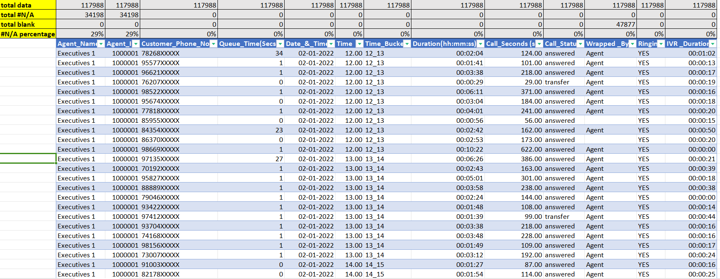
Cleaning the dataset :
The agent Name and Agent Id has null values.
The columns Ringing and IVR duration are not used since ringing has only one variable and IVR duration is not of any use to our analysis.

Slide 5
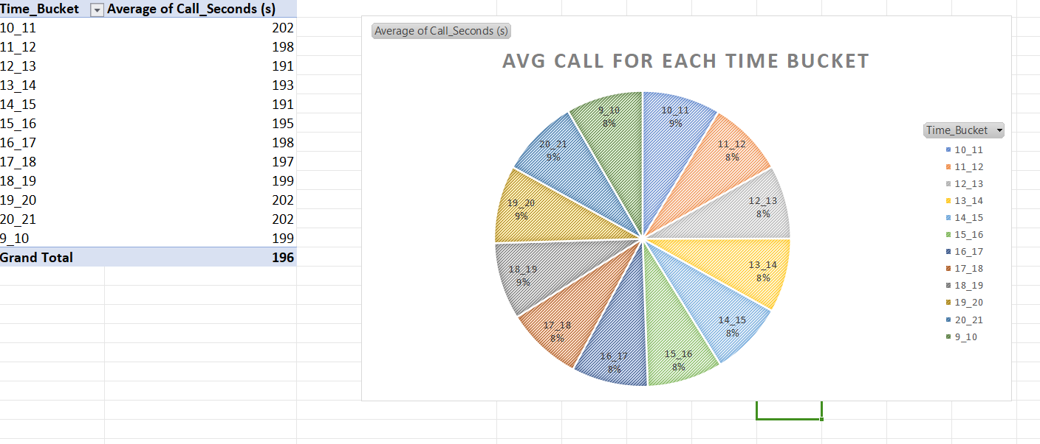
Data Analytics Tasks:
Average Call Duration: Determine the average duration of all incoming calls received by agents. This should be calculated for each time bucket.
Insight:
As it can be seen that avg call duration increases between 10-11 & 18-21 time bucket.

Slide 6
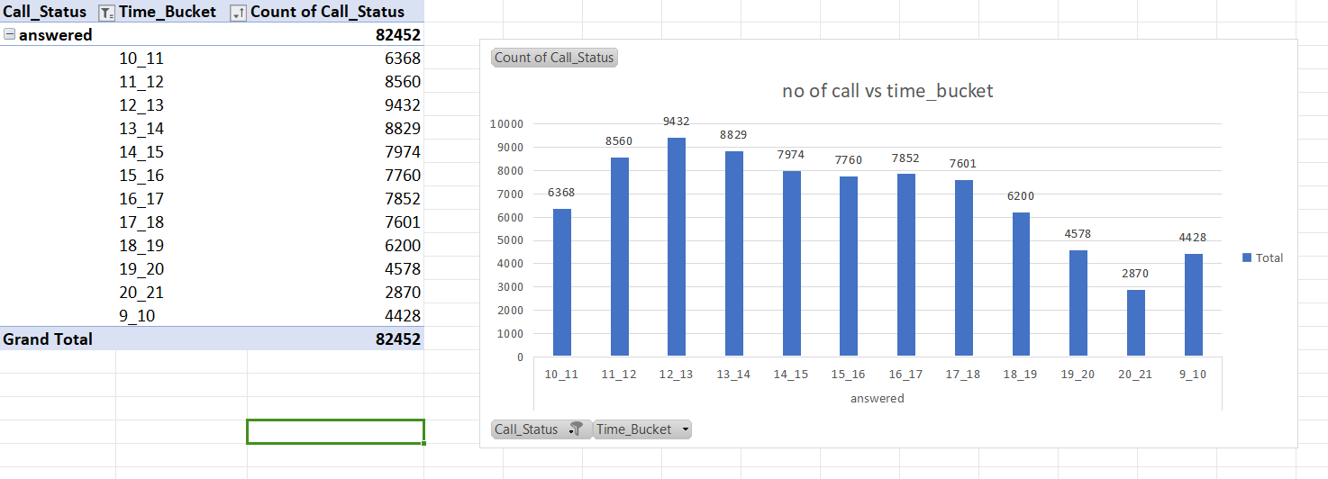
Call Volume Analysis: Visualize the total number of calls received. This should be represented as a graph or chart showing the number of calls against time. Time should be represented in buckets (e.g., 1-2, 2-3, etc.).
Insight:
It can be seen that the Number of calls recieve in a day increases from 9 to 13 and then it starts decreasing.

Slide 7
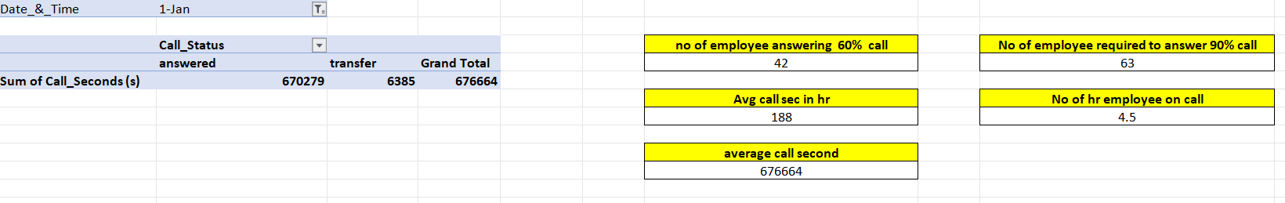
Manpower Planning: The current rate of abandoned calls is approximately 30%. Propose a plan for manpower allocation during each time bucket (from 9 am to 9 pm) to reduce the abandon rate to 10%. In other words, you need to calculate the minimum number of agents required in each time bucket to ensure that at least 90 out of 100 calls are answered.
Assumptions: An agent works for 6 days a week; On average, each agent takes 4 unplanned leaves per month; An agent's total working hours are 9 hours, out of which 1.5 hours are spent on lunch and snacks in the office. On average, an agent spends 60% of their total actual working hours (i.e., 60% of 7.5 hours) on calls with customers/users. The total number of days in a month is 30.

Slide 8
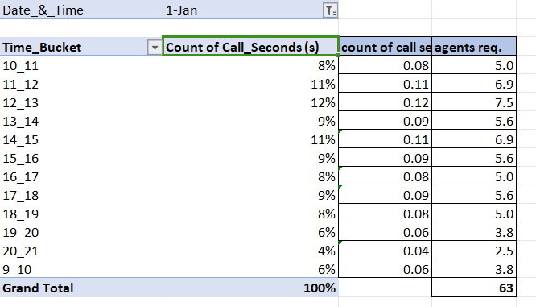
Insight:
Total time spend on calls by agents(according to given assuptions) =7.5*60%(occupancy) =4.5
(1st Jan)Average call duration is 676664.sec
Average call duration in hrs is 188.hr
No of agents attending 60% calls= Avg call duration/total time spend on call by agents=42.
No of agents required to attend 90% call= 90*42/60=63.
Formula that I have used to find number of agent first count the call percectage then convert it into decimal then multiply with the total agents required.

Slide 9
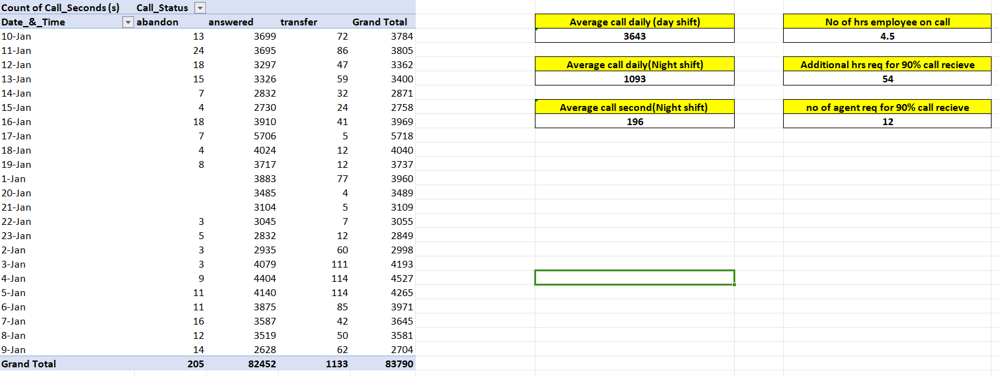
Night Shift Manpower Planning: Customers also call ABC Insurance Company at night but don't get an answer because there are no agents available. This creates a poor customer experience. Assume that for every 100 calls that customers make between 9 am and 9 pm, they also make 30 calls at night between 9 pm and 9 am. The distribution of these 30 calls is as follows:
Your Task: Propose a manpower plan for each time bucket throughout the day, keeping the maximum abandon rate at 10%.

Slide 10
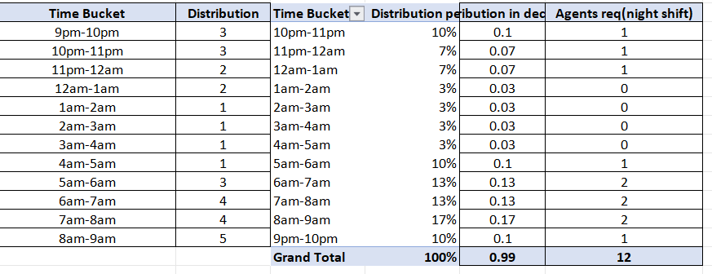
Insight:
we know that total average calls between 9 am to 9 pm is 3643.sec.
so we can say no of call between 9 pm to 9 am is 3643*30/100. That is 1093.sec.
Time to answer 90% of calls in hrs =(total avg calls * total avg duration * 90%)/3600(convert sec into hrs) =(1093*196*90/100)/3600 =54
So number of person required in night =total call time/total time spend on calls
=54/4.5 =12
Formula that I have used to find number of agent first count the call percectage then convert it into decimal then multiply with the total agents required.

Slide 11
Result:
After doing this project, I get to know pivot table more. Pivot helps to compare columns and makes calculation more simple also helps in grouping.
In this project ABC Call Volume Trend Analysis we analysis customer experience. A customer experience team consists of professionals who analyse customer feedback and data, and share insights with the rest of the organization. Keep a good customer relationship that help business for future growth. The project done through using wps office excel. So it help me to increase my technical skills and knowledge in excel. In this analysis project I have analysis the customer relationship, to solve customer problem that keep good relationship between the business and customer. After doing this project this help me to improve my data analytical skills, visualization skills etc.
Link for Excel sheet:
https://docs.google.com/spreadsheets/d/1UbPxiJcxGFGGoGDDov4ChpXj0B0Bidru/edit?usp=drivesdk&ouid=111398243446314990339&rtpof=true&sd=true

